Slide 1
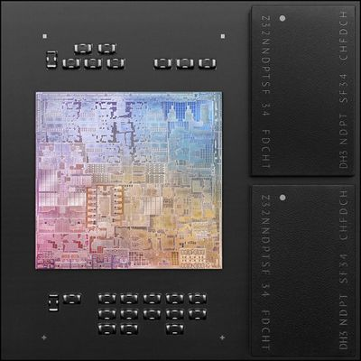
Apple M1 CPU
With industry-leading performance, powerful features, and incredible efficiency, M1 is Apple’s first chip designed specifically for the Mac

Slide 2
As a "System on a Chip," the M1 integrates several different components, including the CPU, GPU, unified memory architecture (RAM), Neural Engine, Secure Enclave, SSD controller, image signal processor, encode/decode engines, Thunderbolt controller with USB 4 support, and more, all of which power the different features in the Mac.
The unified memory architecture that Apple has included is also a major factor because all of the technologies in the M1 are able to access the same data without having to swap between multiple pools of memory.
Built into the M1 chip, the unified memory architecture lets the CPU, GPU, and other processor components don't need to copy data between one another, and are able to access the same data pool. This brings notable speed and efficiency improvements to the M1.

Slide 3
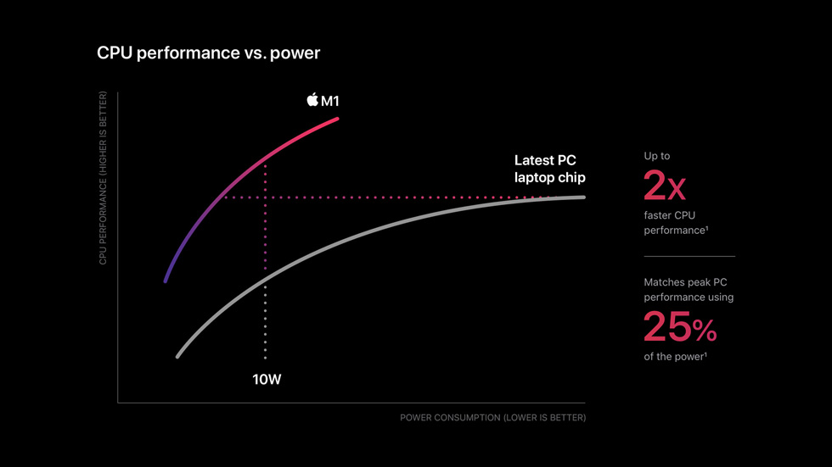

Slide 4
CPU
The M1 chip includes an 8-core CPU with four high-performance cores and four high-efficiency cores. The high-performance cores are designed to offer the best performance for power-intensive single-threaded tasks.
For tasks that are less intensive and don't require the same power, such as web browsing, there are four high-efficiency cores that use a tenth of the power to preserve battery life.

Slide 5
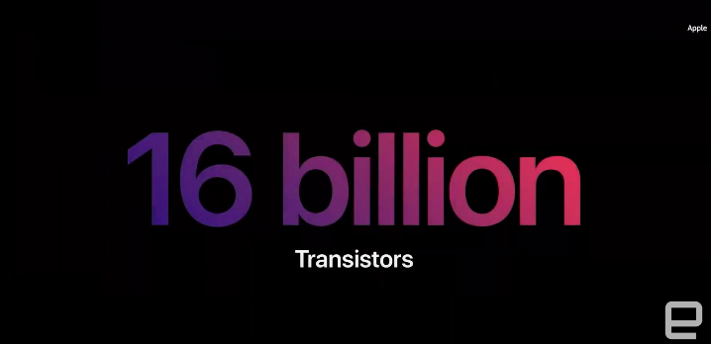
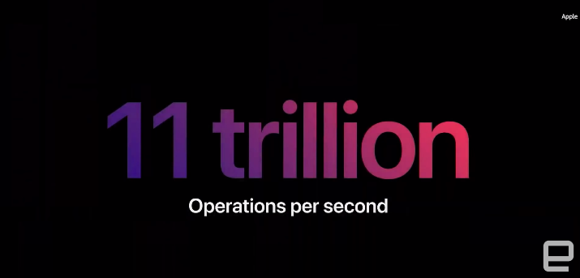
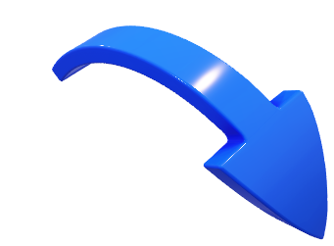

Slide 6
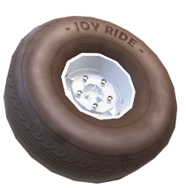
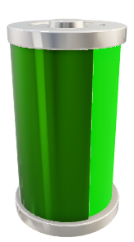
Speed and Battery life
Apple M1 Speed
The M1 chip brings up to 3.5x faster CPU performance, up to 6x faster GPU performance, and up to 15x faster machine learning capabilities compared to the Intel chips used in prior-generation machines.
Compared to the latest PC laptop chips, the M1 offers 2x faster CPU performance and does so using just 25 percent of the power.
Battery Life
Even with the incredible speed improvements that the M1 chip brings, it is also more battery-efficient than any other Mac chip Apple has released to date.
Battery life in an M1 Mac lasts up to 2x longer than in prior-generation Macs. The Mac with the longest battery life is the 13-inch MacBook Pro, which lasts for up to 20 hours. That's double the battery life of the prior-generation model.

